Slide 1
Brain Teaser
There is a calculator in which all digits(0-9) and the basic arithmetic operators(+,-,*,/) are disabled. However other scientific functions are operational like log, sin, cos, arctan, etc. The calculator currently displays a 0. Convert this first to 2 and then to 3 .
Use only x^2, x^-1, log, 10^x, ln, e^x, sin, cos, tan, Arcsin, Arccos, Arctan.

Slide 2
Stock Competition Update
Who’s Hot : David – Alpha Natural Resources Inc.
Pauline – Expedia Inc.
James – Google
Who’s Not: Alec – Netflix
Mike – Sears Holding Corp.
Avinash – Facebook

Slide 3
Externship Apps
Also externship applications are due Monday October 1st
12 pm – Sophomores
2 pm – Juniors
4 pm – Seniors
Powerpoint and more info on career.cornell.edu

Slide 4
Current Events

Slide 5
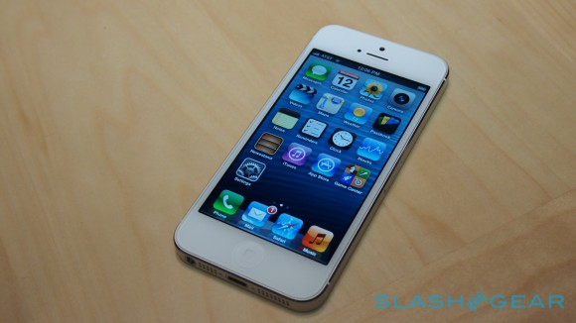
Apple Stock falls back under $700
Since last week, Apple stock has been steadily falling and has returned to about $670 a share
This fall occurs despite a record 5 million iPhone 5 sales its opening weekend
Production issues
Apple vs. Google maps

Slide 6
Other Stocks of Note
Oil (barrel)
90.92 (down)
Gas ($/million BTUs)
2.94 (up)
Gold (troy ounce)
1,766.40 (up)
Silver (troy ounce)
33.94 (down)

Slide 7
Libor
The London Interbank Offered Rate is the average interest rate estimated by leading banks in London that they would be charged if borrowing from other banks
Libor rates are calculated for ten different currencies and 15 borrowing periods ranging from overnight to one year and are published daily at 11:30 am (London time) by Thomson Reuters

Slide 8
Libor- Controversy
On Thursday, 29 May 2008, the Wall Street Journal released a controversial study suggesting that banks might have understated borrowing costs they reported for Libor during the 2008 credit crunch

Slide 9
Libor
On 28 February 2012, it was revealed that the US Department of Justice was conducting a criminal investigation into Libor abuse
Traders were in direct communication with bankers before the rates were set
This allowed traders an advantage in predicting that day's fixing
Libor underpins approximately $350 trillion in derivatives
Each basis point Libor was moved could “net a couple million dollars”, according to one trader

Slide 10
Libor
As a result of the US D.o.J investigation, Barclay’s Bank was fined over 400 million dollars on June 27th
On July 27, 2012, the Financial Times published an article by a former trader which said that Libor manipulation has been common since at least 1991. Further reports on this have since come from the BBC and Reuters.
After the US investigation revealed the bredth of the scandal, On July 6, it was announced that the U.K. Serious Fraud Office opened its own investigation

Slide 11
Interview
Tom – interviewer
Kyle – Technology Analyst Interviewee
Start with behavioral questions
Tell me about yourself
Conflicts
Working in groups
Case/Brain teaser
Estimate populations

